Slide 1
NEIGHBOURHOOD PLAN UPDATE 2ND NOVEMBER 2024

Slide 2
Aims of Today
To feedback survey results
To set out emerging Neighboured Plan vision, objectives, and broad policy themes for community feedback
Today’s Agenda
Welcome and introductions (including Neighbourhood Plan Committee, Why a Neighbourhood Plan, Timelines, Summary of Survey) | Neighbourhood Plan Committee Led by Sherard Veasey
Next steps in the Plan (including draft vision, objectives, and broad policy themes) | Community First Oxfordshire Tom McCulloch
Question and answer | Tom and Neighbourhood Plan Committee
Discussion session (including feedback on the draft vision, objectives, and broad policy themes) | Tom and Neighbourhood Plan Committee

Slide 3
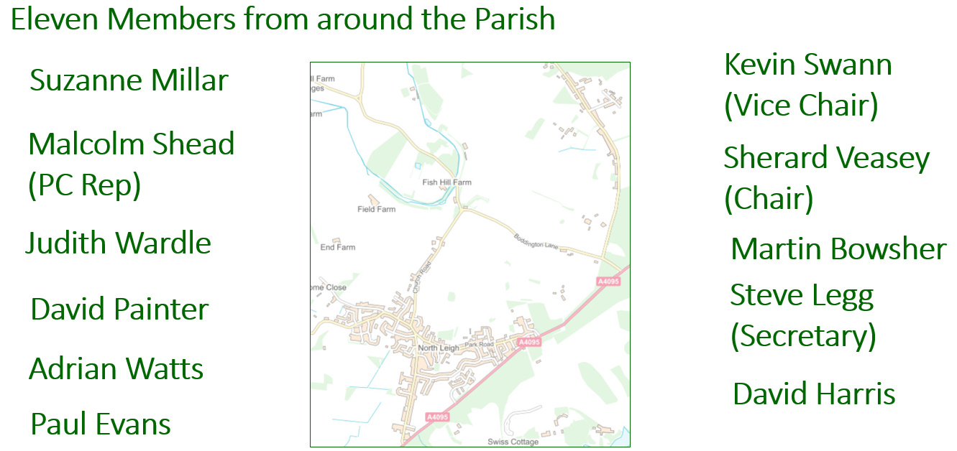
Neighbourhood Plan Committee

Slide 4
What is a Neighbourhood Plan?
Gov.uk says:
“ … Neighbourhood planning is a new way for communities to have a say in the future of the places where they live and work. It gives you the power to produce a plan with real legal weight that directs development in your local area. …”
Note – There has been no change to the status of the Neighbourhood Plan under the new government’s revision of the NPPF.

Slide 5
Some Benefits of a Neighbourhood Plan
We can shape the Parish for ourselves and for future generations
Developers can no longer use lack of a Neighbourhood Plan against us (Manor Oak appeal)
Community Infrastructure Levy “CIL”, more money for North Leigh with a Neighbourhood Plan (25% rather than 10%)
So what are the downsides?
Not much that I can see …
Costs almost all borne by grants - very little cost to the Parish
Time and effort by the Neighbourhood Plan Committee and everyone in the Parish who provides feedback and gets involved

Slide 6
Neighbourhood Plan Projected Timeline
2023
Spring 2024
Summer/ Autumn 2024
Autumn/
Winter 2024
Neighbourhood Plan Project Commences
Launch Event
Survey
Evidence Gathering
Write the Plan policies and evidence base, finalise Design Code
Autumn/
Winter 2025
Autumn 2025
Spring/
Summer 2025
Public Referendum
Examination by West Oxfordshire District Council
Statutory draft Plan and final Plan consultations

Slide 7
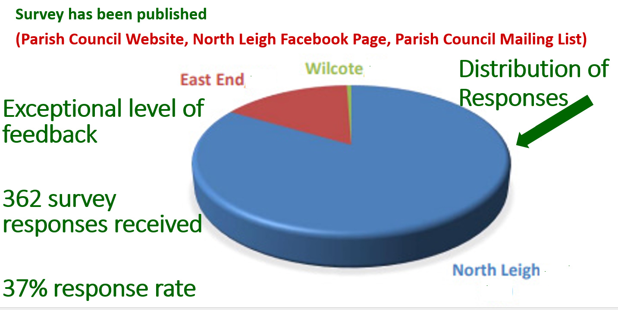
Survey –What Did North Leigh Say?
.
.
.
.
.

Slide 8
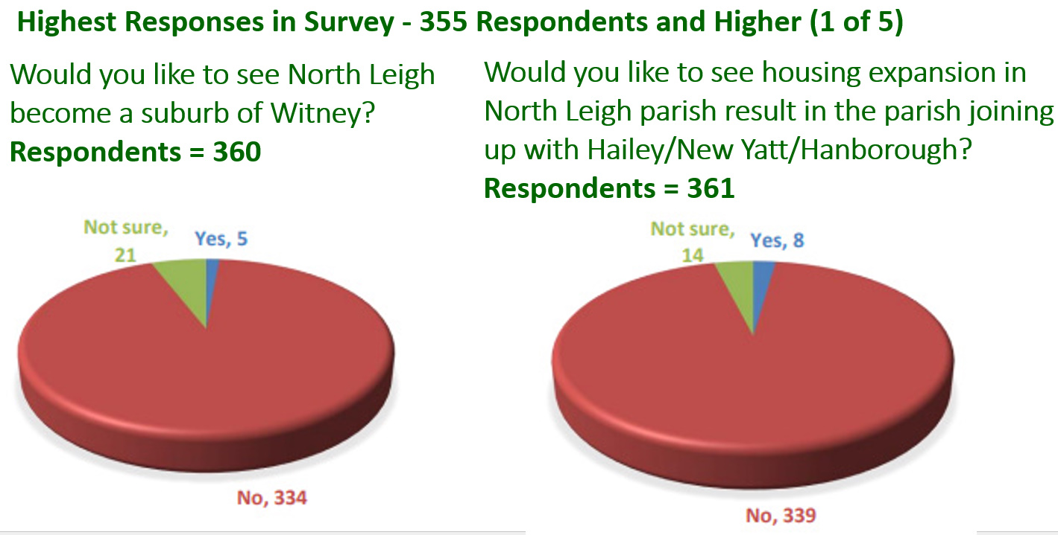
Survey –What Did North Leigh Say?

Slide 9
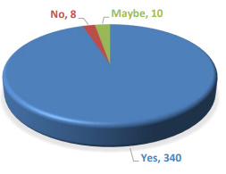
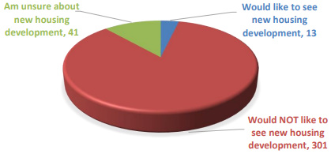
Survey –What Did North Leigh Say?
Highest Responses in Survey - 355 Respondents and Higher (2 of 5)
Would you like to see new housing development in
North Leigh parish?
Respondents = 355
Do you think The Neighbourhood Plan should contain policies to conserve and enhance nature, biodiversity, and wildlife in North Leigh parish?
Respondents = 358

Slide 10
Survey –What Did North Leigh Say?
Highest Responses in Survey - 355 Respondents and Higher (3 of 5)
Question | Respondents | Top Answer(s)
How would you like North Leigh to be described in 15 years | 360 | An inclusive, friendly, safe community, where everyone gets on well and looks out for one another
How important are these characteristics of North Leigh parish to your household | 360 | Access to the countryside Open green spaces/rural views
Are you likely to move home in the next 10 years | 360 | No
In general, how often does your household use public transport | 359 | Never/hardly ever

Slide 11
Survey –What Did North Leigh Say?
Highest Responses in Survey - 355 Respondents and Higher (4 of 5)
Question | Respondents | Top Answer(s)
How serious do you consider the following pollution issues | 359 | Water pollution (e.g. by housing development having exceeded sewerage system capacity)
Please tell us how many cars your household has | 359 | Two
How many people in your household commute to work or school | 358 | None
Do you agree that the following archaeological or historical places and their surroundings should be protected from development | 356 | The Roman Villa at East End

Slide 12
Survey –What Did North Leigh Say?
Highest Responses in Survey - 355 Respondents and Higher (5 of 5)
Question | Respondents | Top Answer(s)
Do you agree that the following woodlands should be protected from development | 355 | Ancient hedgerows throughout the parish
Do you think traffic calming measures e.g. rumble strips, speed humps, should be introduced at key points in the parish | 355 | No
The above is just a snapshot – complete responses are available from the full Survey.
(Parish Council Website, North Leigh Facebook Page, Parish Council Mailing List)

Slide 13
Stay Informed / Get Involved
Stay Informed
If you are not on the North Leigh Parish Council mailing list, please do consider providing your email address today – you will be informed of local matters that may be relevant to you!
Get Involved
If you would like to help out with the Neighbourhood Plan, please let us know.

